Slide 1
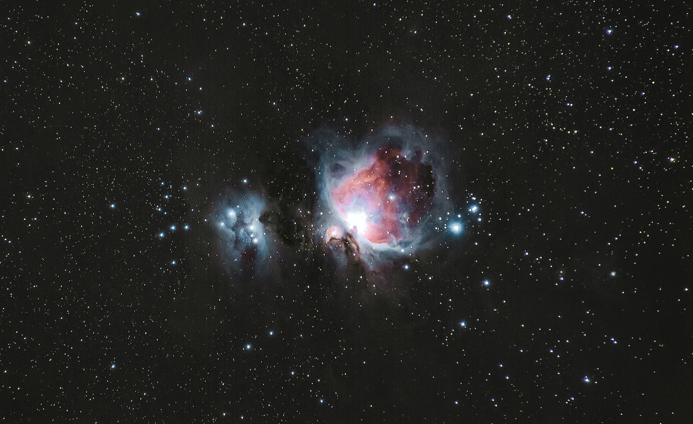

PEAKER
VERIFICATION SYSTEM
Using MFCC and MLP Classifier

Slide 2
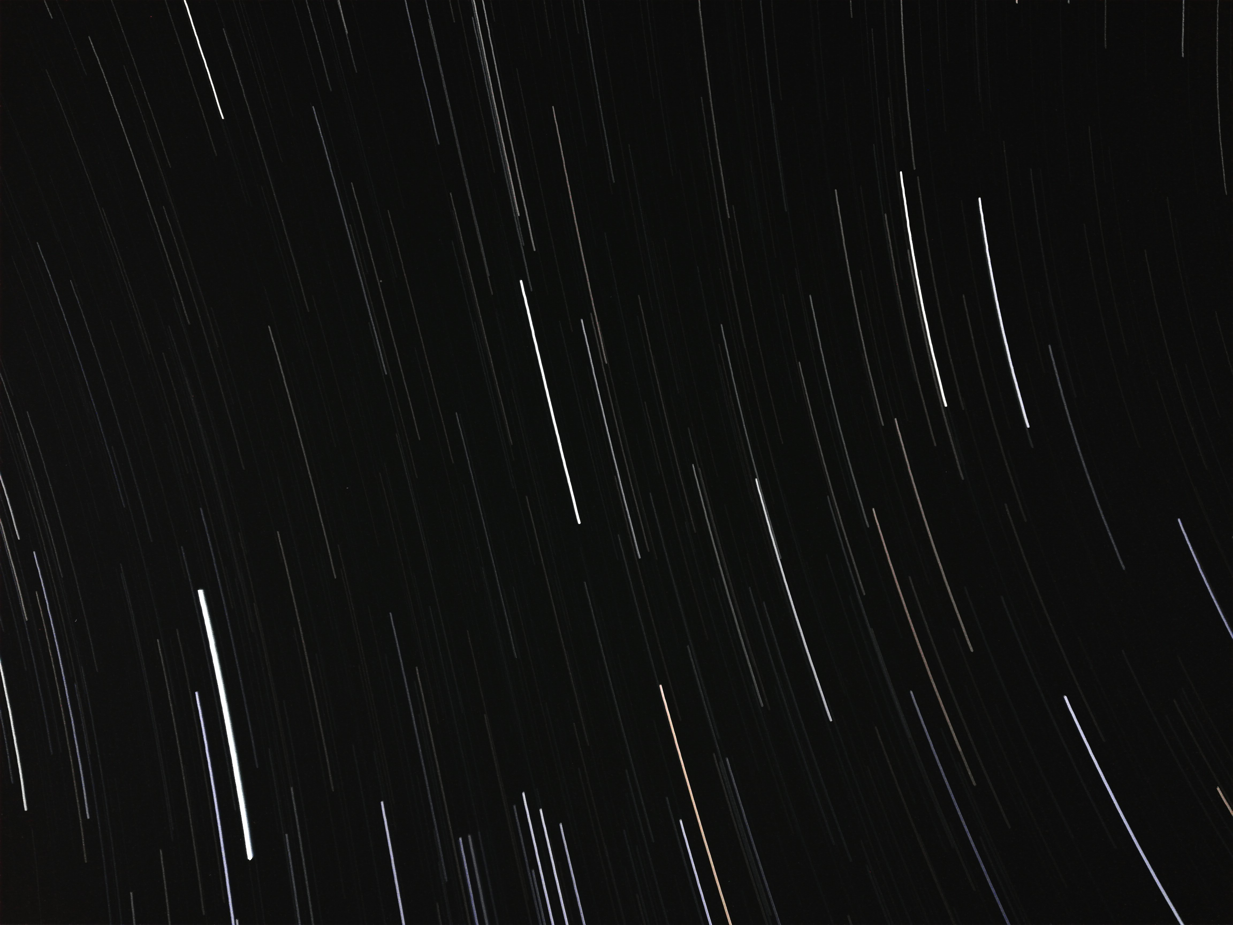
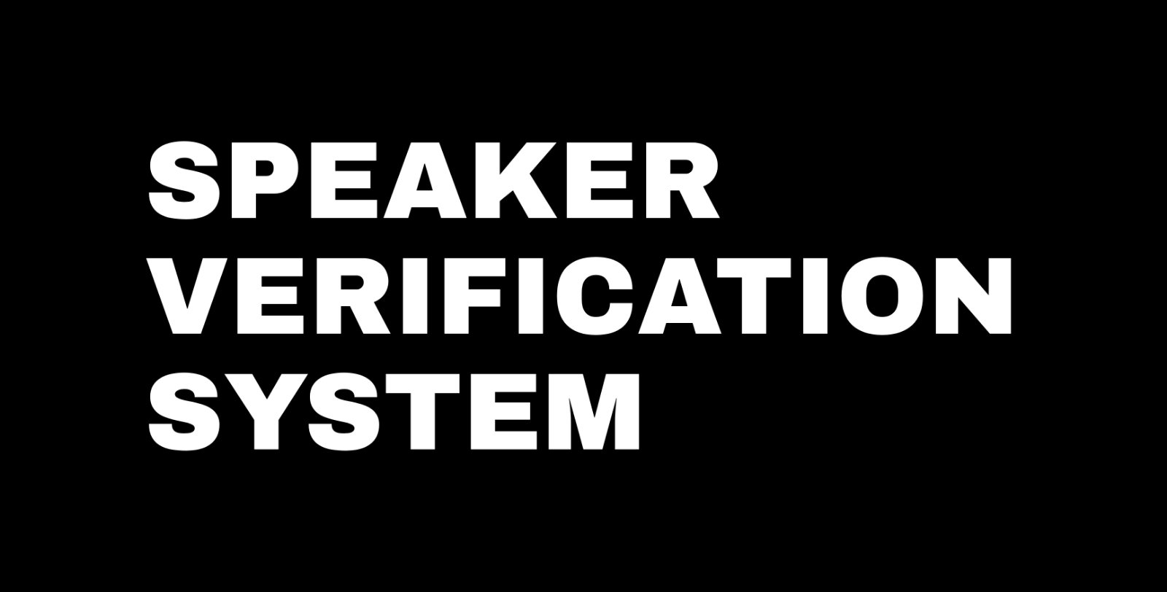


WHY WE MADE SPEAKER VERIFICATION SYSTEM ?
We are motivated by automation of verification systems. So we made a speaker verification system which can be used for authenticating the speaker and can be used as an automated attendance system.
18th Feb 2022

Slide 3
DATASET
We trained our model on two datasets. One of them was Urbansound8K and the other was our own Custom dataset.
18th Feb 2022

Slide 4

URBANSOUND8K
We trained our model first on UrbanSounds8k Dataset.
This audio dataset consists of 8732 labeled sounds from the following 10 classes: car_horn , air conditioner,siren, dogbark, drilling, children_playing,enginge_idling, jackhammer, gun_shot and street_music.
After getting accuracy right we moved on to creating our own dataset and training it on MLP.

Slide 5

Post training accuracy of Urban8Ksound dataset.
The results yielded classification accuracy of 0.91 which is 91% (training) and 0.88 which is 88 % (testing)..
18th Feb 2022

Slide 6
CUSTOM DATA COLLECTION
We have collected data from 19 different speakers. Each speaker has total of 102 voices (.wav files).
There are total 1938 .wav files. From which 19 are kept as unknown test data. These are the files the model have not seen or In other words they are not in the training and testing set.
We have created a .csv file which have labelled data. In which each file has been assigned its respective class.
The dataset has 19 different classes. There is variety of data including Teenagers, male , females , adults and kids.

Slide 7
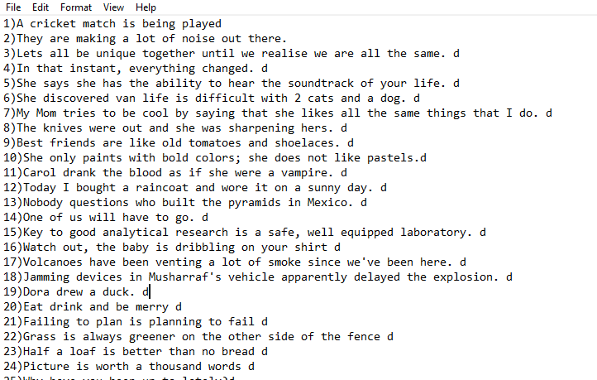
These are the sentences that were used for recording.

Slide 8
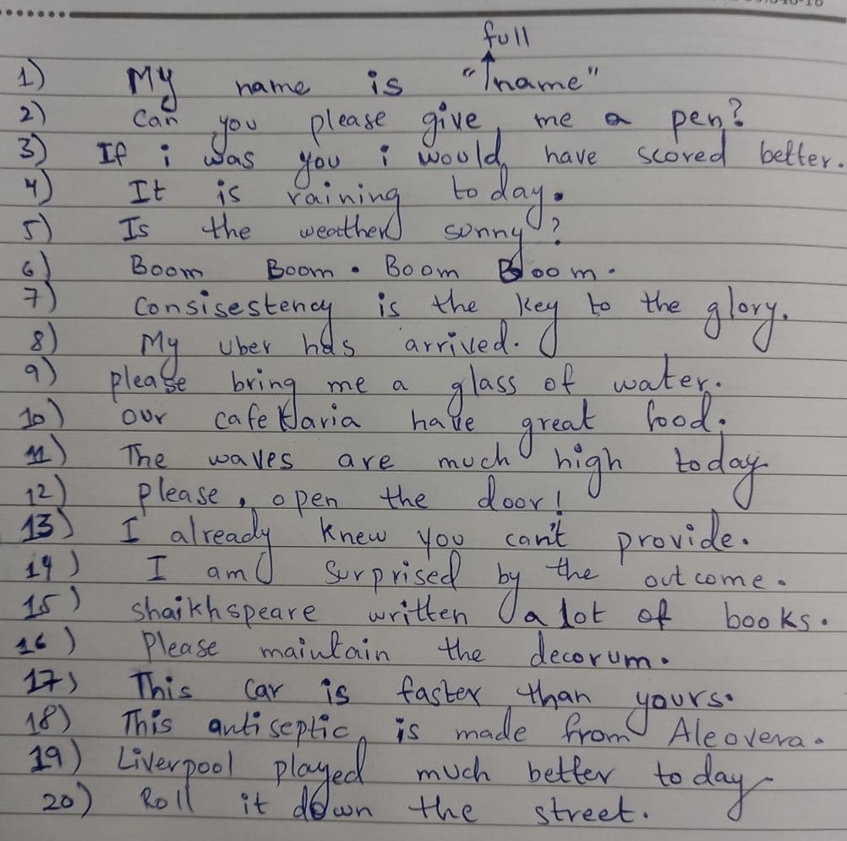
These are the sentences that were used for recording.

Slide 9
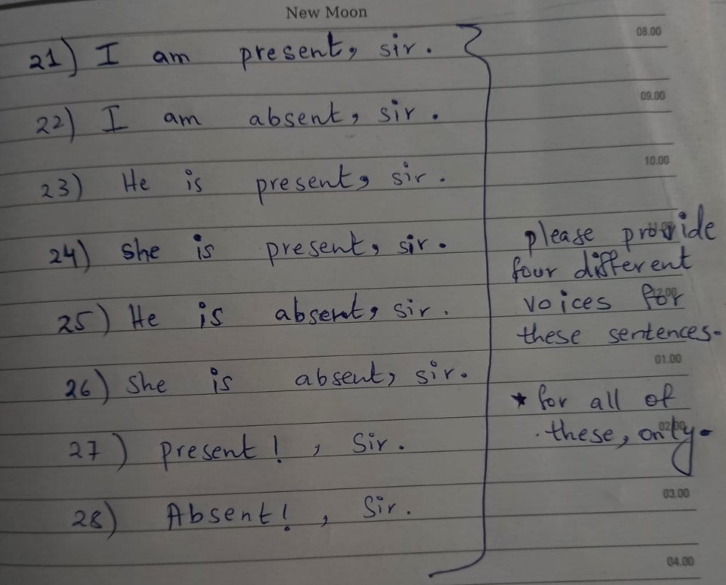
Sentences continued..

Slide 10
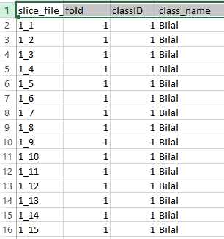
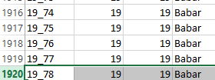
This how our .csv looks like
Each file with its class number and class name.
Total files 1919.

Slide 11
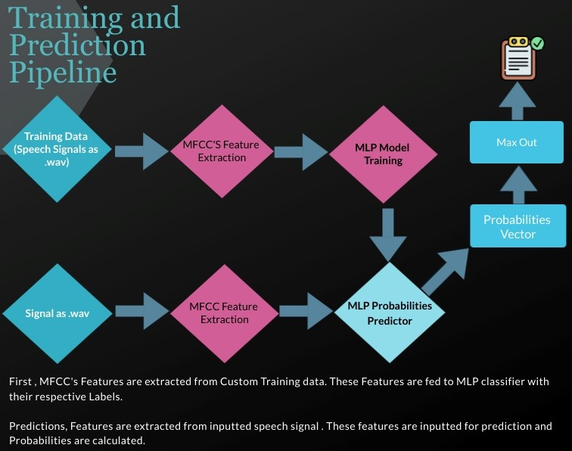
System Pipeline
18th Feb 2022

Slide 12




MFCC FEATURES Generation
MFCC's are defined as “coefficients that represent audio based on perception with their frequency bands logarithmically positioned and mimics the human vocal response"
Step 1
Framing
In this step signal is divided into frames . Usually the frame size is kept small and not too large.
Step overlapping step size is also kept to keep the continuity of signal.
Step 3
Log
Applying log on these frequency bands. To mimic human vocal response.
DCT(discrete cosine transform) is applied on logarithm frequencies.
Step 2
Filter Banks
These frames are converted into filter banks. By convert each frame frequency into MEL scale.
Mel scale formula:
M (f) = 1125*(ln (1+f/700) )
Step 4
DCT

Slide 13
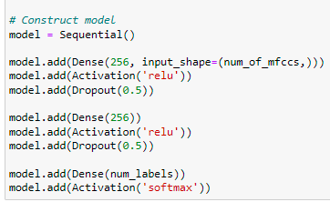
SYSTEM MODEL and Classification
Our Speaker Verification system is using a fully connected MLP classifier which is composed of :
Input layer with input equal to number of mfcc’s generated with Relu activation and dropout 0.5.
Hidden layer with activation Relu and dropout 0.5.
Output layer with output equal to number of classes with Relu activation and dropout 0.5.
18th Feb 2022

Slide 14
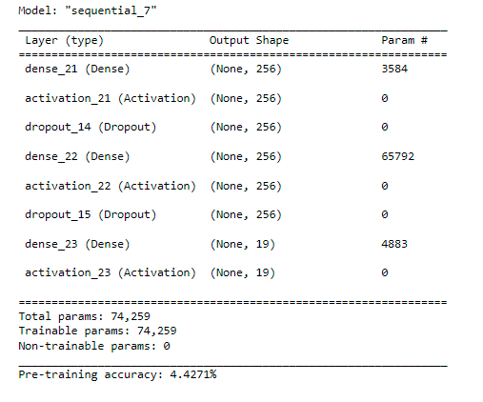

Pre Training Accuracy using MLP
Post training Accuracy and Loss using MLP Classifier
18th Feb 2022

Slide 15

THANK YOU!
17

